Slide 1
Embedding Power BI Content in Your Application
Ted Pattison
Power BI Customer Advisory Team (PBICAT)

Slide 2


Power BI Embedded in a nutshell
Leverage decades of analytics expertise and machine learning IP
No end user licensing required (ISV scenario)
Designed for software companies (white labeling)
Programmatically control visuals, layout and user experience

Slide 3
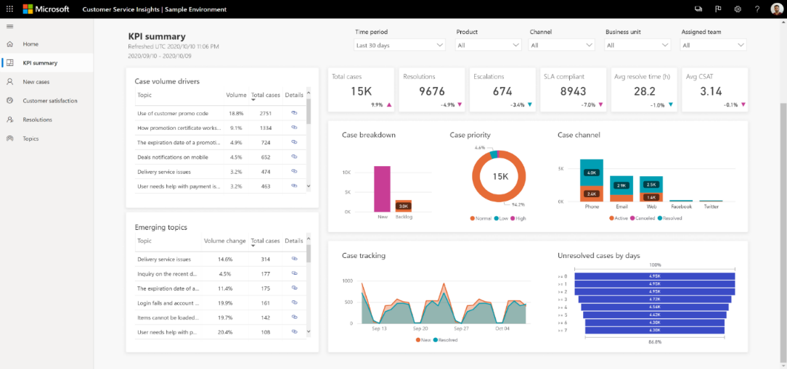
Client-side Programming with the Power BI JavaScript API
Programmatically configure and control the UX and the visualization
JavaScript API
Hosting application
Embedded report
iFrame boundary

Slide 4

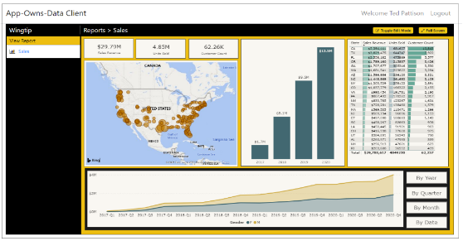
Customer Tenants in App-Owns-Data Embedding
Tenant represents a customer with one or more users
You must create a separate tenant footprint in Power BI for each customer
Power BI environment
Customer 01
17 users
Customer 01 Tenant
Sales
Power BI Workspace
Power BI Dataset
Datasource credentials
Power BI Report

Slide 5
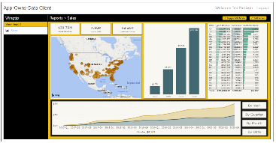
Designing a Multi-tenant Environment
Power BI Multi-tenant Environment
Customer 01
17 users
Customer 01 Tenant
Sales
Power BI Workspace
Power BI Dataset
Datasource credentials
Power BI Report
Customer 02
243 users
Customer 02 Tenant
Sales
Power BI Workspace
Power BI Dataset
Datasource credentials
Power BI Report
Customer N
74 users
Customer N Tenant
Sales
Power BI Workspace
Power BI Dataset
Datasource credentials
Power BI Report

Slide 6
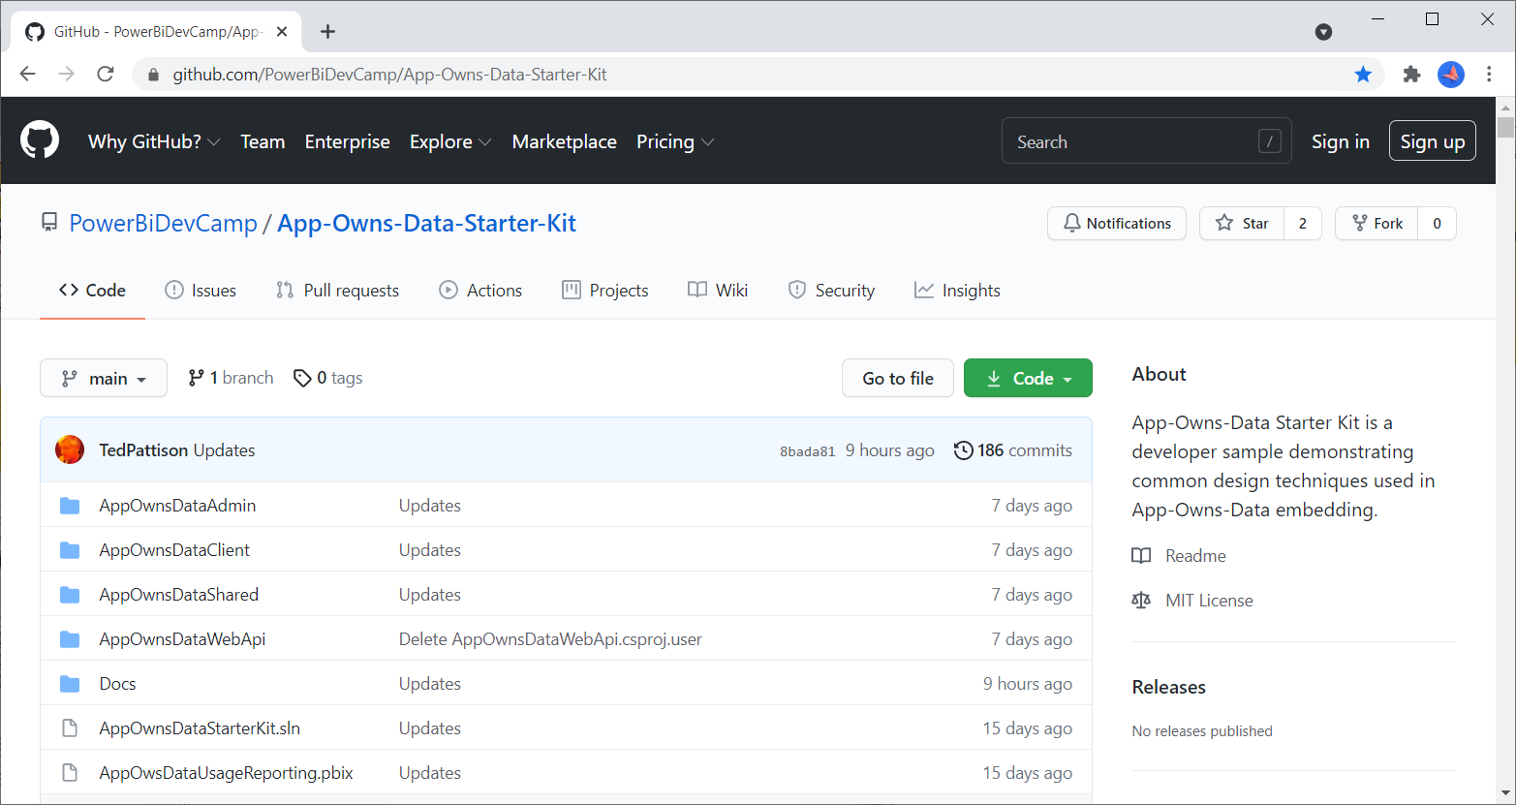
App-Owns-Data Starter Kit on GitHub
https://github.com/PowerBiDevCamp/App-Owns-Data-Starter-Kit

Slide 7
App-Owns-Data Starter Kit Architecture
AppOwnsDataDB: custom database to track tenants, user permissions and user activity
AppOwnsDataAdmin: administrative app to create tenants and manage user permissions
AppOwnsDataWebApi: custom Web API used by client-side SPA applications
AppOwnsDataClient: customer-facing SPA used to view and author reports (JavaScript & JQuery)
AppOwnsDataReactClient : customer-facing SPA used to view and author reports (modern React-JS)
AppOwnsDataAdmin
AppOwnsDataDB
Power BI REST API
AppOwnsDataClient
AppOwnsDataWebApi
AppOwnsDataReactClient

Slide 8
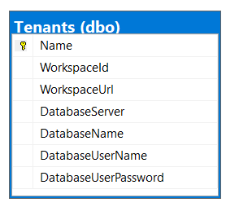
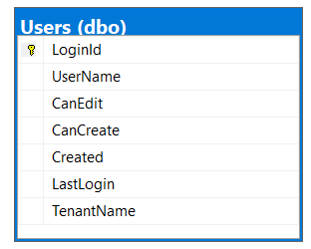
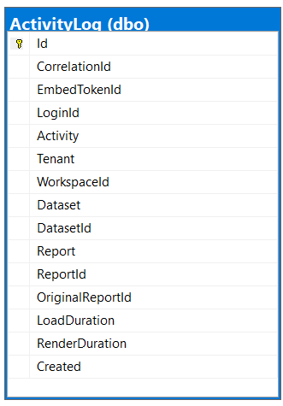
Database Schema for AppOwnsDataDB
Tenants table tracks Power BI workspace Id and customer database connection info
Users table tracks user profile with tenant assignment and permissions within tenant
ActivityLog table tracks telemetry data about user activity and report performance

Slide 9
AppOwnsDataWebApi
Provides service-oriented architecture endpoints for AppOwnsDataClient
Provides endpoint to process user login
Provides endpoint to retrieve embedding data and embed tokens
Provides endpoint to log activity events to be recorded in AppOwnsDataDB
AppOwnsDataReactClient
AppOwnsDataWebApi
Power BI REST API
Azure AD Client App
Azure AD Service App
AppOwnsDataDB

